Slide 1
Semiconductor Industry Supply Chain Dynamics: A Simplified Overview
A presentation by
Nina Chen
Raghavendra Pariti
Sandeep Modugu
Akshaj Khirwadkar

Slide 2
Problem Statement
The semiconductor industry is characterized by a highly complex and globally integrated supply chain process. Often encompassing various stages like design, manufacturing, testing, and distribution, often spanning multiple countries.
However, its supply chain is driven by complexities and variabilities arising from manufacturing processes, customer demands, and quality control requirements.
This complexity is further amplified by the need for meticulous coordination among diverse entities such as foundries, testing facilities, and packaging units, along with adherence to stringent quality standards and customer specifications.
This interconnected network of processes underscores a critical need for a sophisticated, centralized data management system, poised to integrate data, facilitate real-time tracking, and to foster decision-making.

Slide 3
Our main objective is to develop a sophisticated database designed to streamline supply chain management within the semiconductor industry.
This database is strategically developed to facilitate
Analytical Assessment of Foundry Performance and Efficiency: By evaluating operational metrics, we can drive improvements in the manufacturing process.
Comprehensive Financial Performance Analysis: This will enable a deeper understanding of cost implications and investment returns.
Performance-to-Cost Ratios: Offering insights into the value derived from each expenditure, enhancing economic efficiency.
Rigorous Quality Control and Monitoring: Our database meticulously tracks and analyzes the performance of each foundry, showcasing their success rates in critical testing areas such as wafer, functional, and visual inspections, as well as their proficiency with different levels of automated testing equipment.

Slide 4
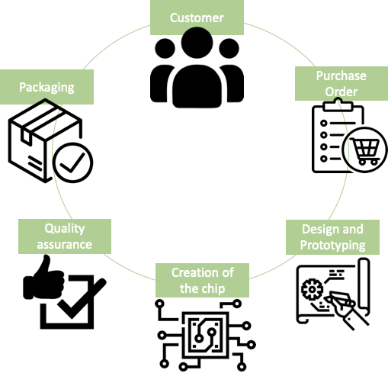
Semiconductor Manufacturing Process Overview

Slide 5
Assumptions
Chip Design Simplification
Foundry Costs Omission
Limited Testing Parameters
Exclusion of Chip Storage
Logistics Simplification
Market Dynamics
Third-Party Vendors & contractors omission
Trade and Geopolitics effect
Purchase Order to Customer ratio

Slide 6
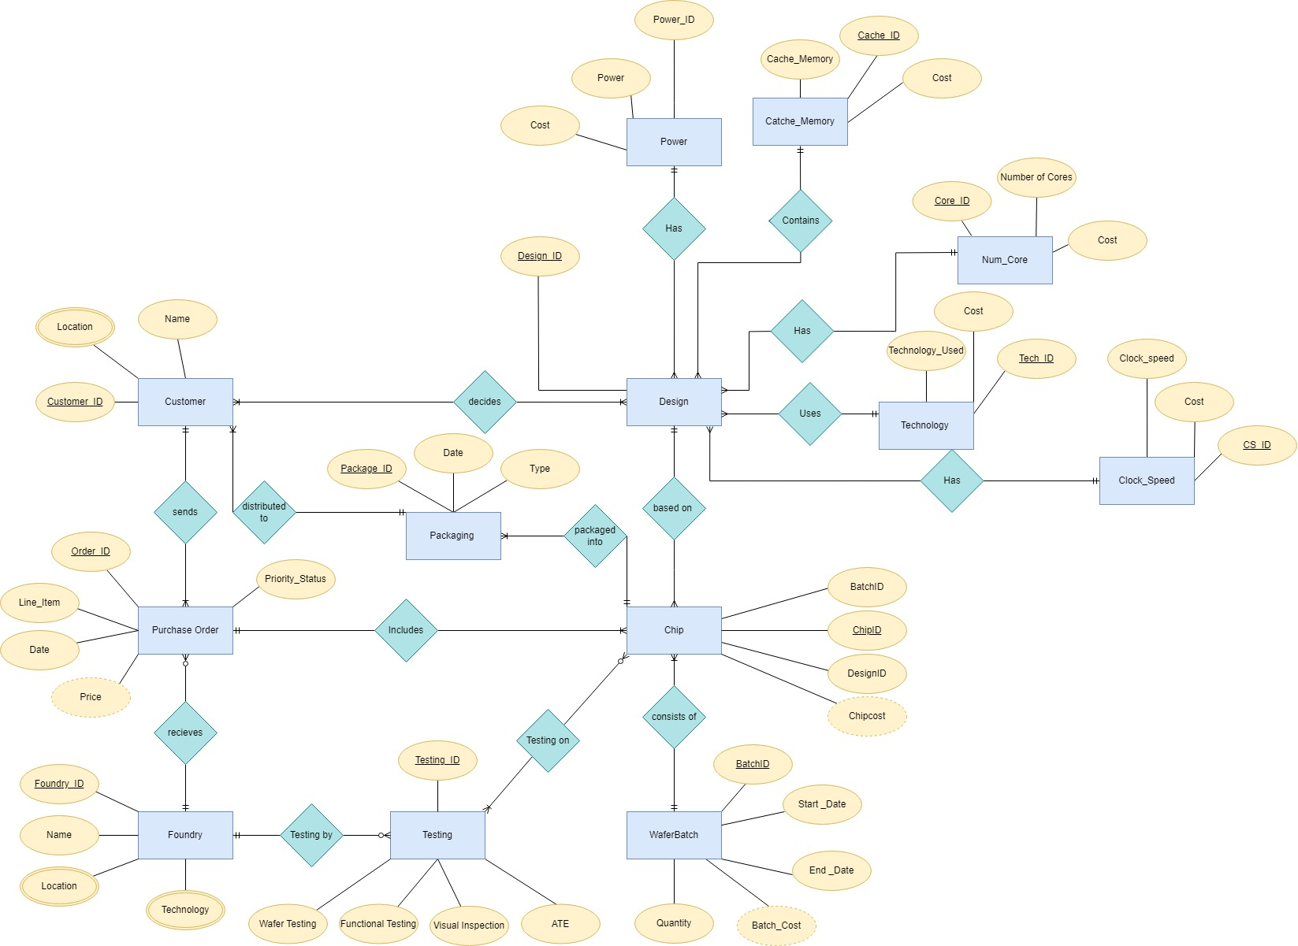

Slide 7
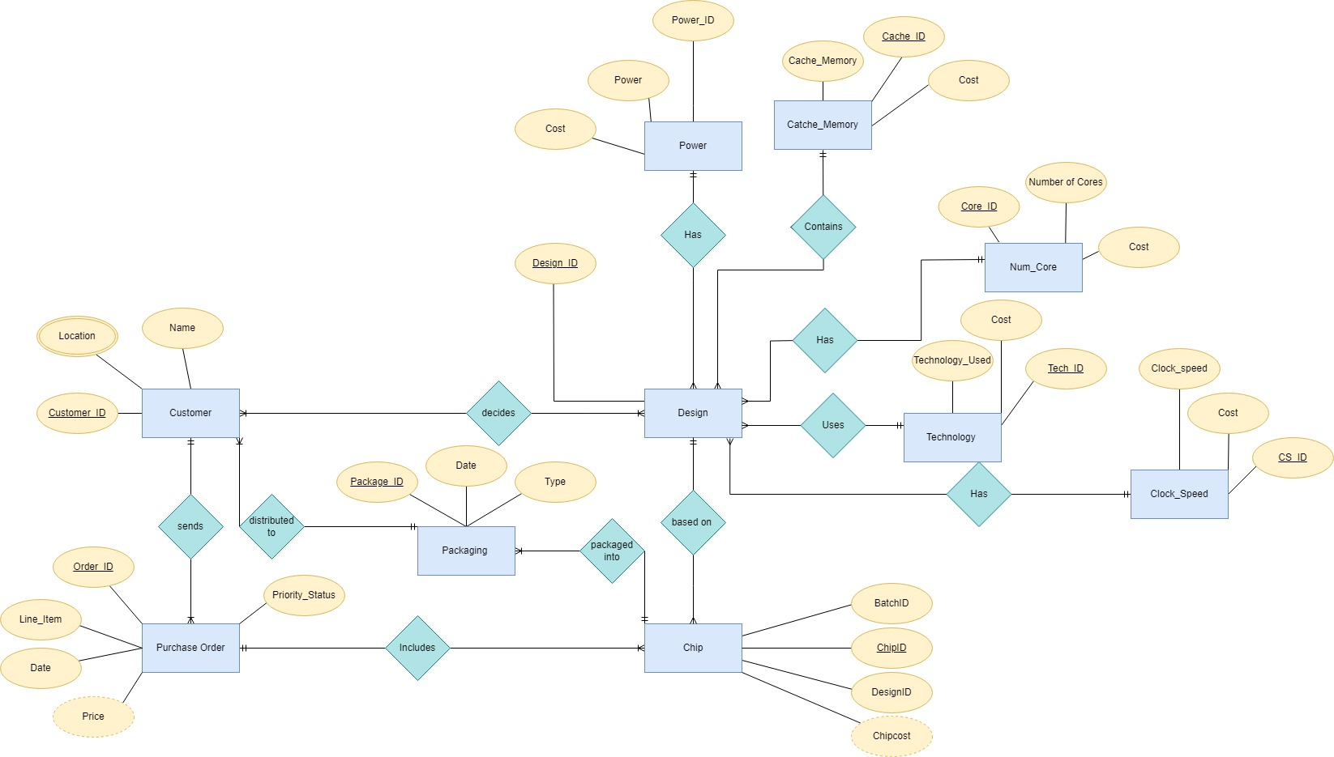
Part – 1 of ER Diagram
Customer
Attributes : Customer_ID. Location, Name
Design
Attributes : Design_ID
Power
Attributes : Power_ID, Power, Cost
Cache Memory
Attributes : Cache_ID, Cache_Memory, Cost
Num Core
Attributes : Core_ID, Number of Cores, Cost
Technology
Attributes : Tech_ID, Technology_Used, Cost
Clock_Speed
Attributes : CS_ID, Clock_Speed, Cost

Slide 8
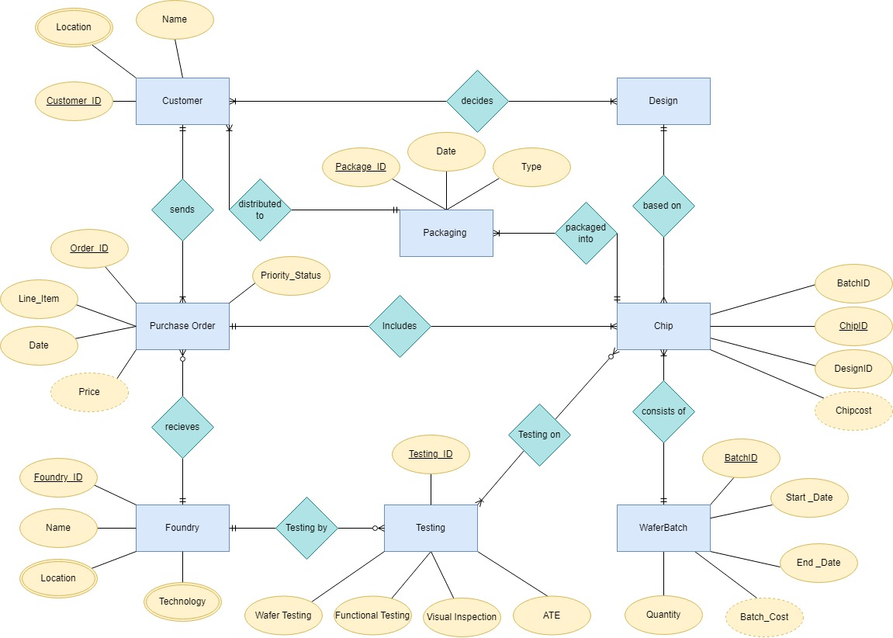
Part – 2 of ER Diagram
Chip
Attributes : ChipID, BatchID, DesignID, Chipcost
WaferBatch
Attributes : BatchID, Start_Date, End_Date, Batch_Cost, Quantity
Testing
Attributes : Testing_ID, Wafer Testing, Functional Testing, Visual Inspection, ATE
Foundry
Attributes : Foundry_ID, Name, Location, Technology
Packaging
Attributes : Package_ID, Date, Type

Slide 9
Relational Schema Mapping of the ERD
Customer (Customer_id, Name, Package_ID[FK])
Cust_loc (customer_id[FK], Location)
Purchase_Order(Order_Id, Line_item, Date, Priority_Status, Customer_Id[FK], Foundry_ID[FK])
Foundry(Foundry_ID, Name, Technology)
Foundry_Loc (Foundry_ID[FK], Location)
Testing (Testing_ID, Wafer_Testing, Functional_Testing, Visual_Inspection, ATE, Foundry_ID[FK])
Testing_ON (Testing_ID[FK], Chip_ID[FK] )
WaferBatch(Batch_ID, StartDate, EndDate, Quantity)
Chip(ChipID ,BatchID[FK], Order_ID[FK], Design_ID[FK])
Packaging(PackageId, Date, Type, ChipID[FK])
Decides(Customer_ID[FK], Design_ID[FK])
Design(Design_ID, CS_ID[FK], Tech_ID[FK], Core_ID[FK], Cache_ID[FK], Power_ID[FK])
Clock_Speed(CS_ID, Clock_Speed, Cost)
Technology(Tech_ID, Technology_Used, Cost)
Num_Core(Core_ID, Number_of_Cores, Cost)
Cache_Memory(Cache_ID, Cache_Memory, Cost)
Power(Power_ID, Power, Cost)

Slide 10
Foundry Performance and Efficiency Analysis
In the semiconductor industry, where production speed, cost efficiency, and the capacity to fulfill orders are crucial, assessing the overall performance of a foundry is essential. This involves considering not only how quickly and cost-effectively a foundry can produce chips but also its ability to handle and complete customer orders.
The following metrics are crucial for this analysis:
Production Efficiency Rate: This measures the average number of chips produced per day, indicating the foundry's production speed and capacity.
Cost Efficiency Ratio: This ratio reflects how cost-effectively the foundry operates, calculated by dividing the total production cost by the average production time in days. It provides insight into the foundry's cost management relative to its production timeline.
Foundry Efficiency Ratio: A crucial metric for this analysis, calculated by dividing the Production Efficiency Rate by the Cost Efficiency Ratio. A higher ratio suggests a better balance between production speed and cost-effectiveness, indicating a more efficient overall operation.
Total Orders: Reflects the foundry's market demand and capacity to handle customer orders, with a higher number of orders possibly indicating better market trust and operational capability.

Slide 11
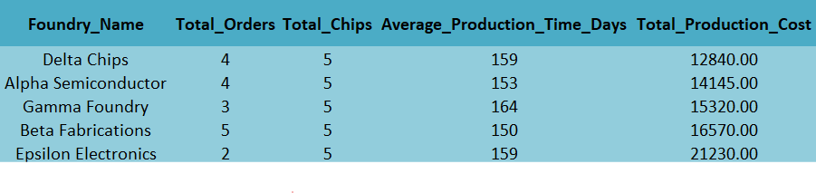
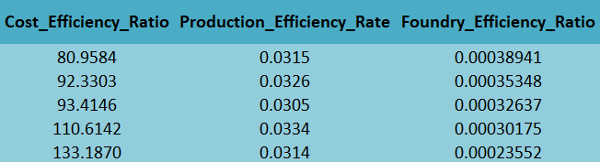
SQL Query – 1
Which semiconductor foundry exhibits the best balance of production efficiency, cost management, and order fulfillment capacity?
Output
This SQL query analyzes foundry efficiency, guiding businesses in enhancing supply chain operations and forging partnerships with the most effective producers. The insights gained can streamline production, improve cost management, and influence targeted investments in promising technologies, bolstering a company's market competitiveness and financial performance.

Slide 12
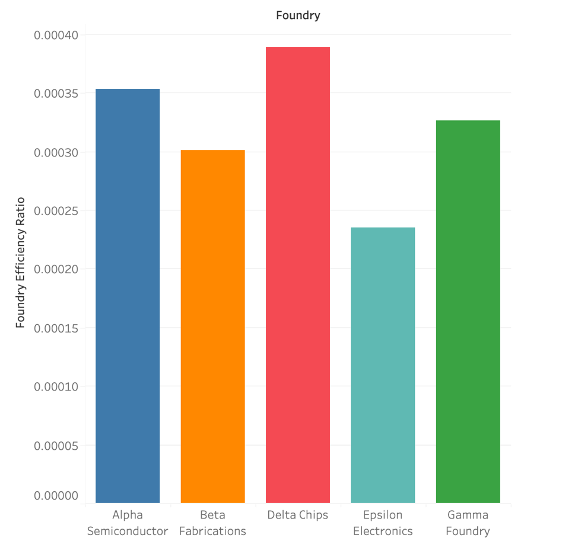
Visualizing Results

Slide 13
Necessity of Financial Analysis
The semiconductor industry is characterized by intensive capital and research investments, resulting in a complex web of costs associated with design, manufacturing, and testing of chips.
Companies in this sector need to maintain a delicate balance between the costs incurred in designing and producing chips and the revenues generated from their sales.
Accurate financial performance analysis is critical to ensure profitability, competitive pricing, and optimal allocation of resources.
To quench this need of specific metrics and evaluate customers based on their performance I have designed a couple of queries.

Slide 14
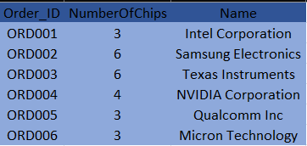
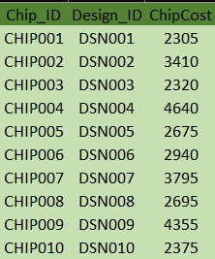
SQL Query – 2
Justification - Matching Purchase Orders with customers and number of chips :
This query is essential for financial reporting and supply chain management as it aligns product output (chips) with customer orders.
It enables the company to monitor production efficiency and customer fulfillment. Moreover, it serves as a foundation for customer relationship management, inventory tracking, and revenue forecasting by showing the number of chips each customer is receiving.
Purchase Orders with Number of Chips and Customers
Chip Cost
Justification – Chip Cost Query
This query is vital for cost analysis and pricing strategy as it provides a detailed breakdown of each chip's production cost.
By aggregating the costs of individual components, it helps in identifying the most expensive parts of the chip's design, which could be targeted for cost reduction efforts. Additionally, it informs pricing decisions to ensure profitability and competitiveness in the market.

Slide 15
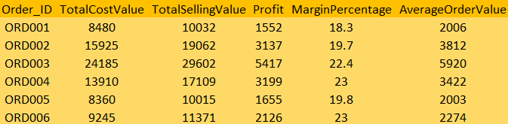
Financial Overview
Justification -
This query is essential for financial analysis and reporting. It helps in understanding the profitability of each order by calculating the cost, selling value, and profit, accounting for the margin.
The average order value is also determined under the assumption that each purchase order consists of five chips, which can help in assessing the revenue per unit and making informed decisions about pricing strategies and discount policies

Slide 16
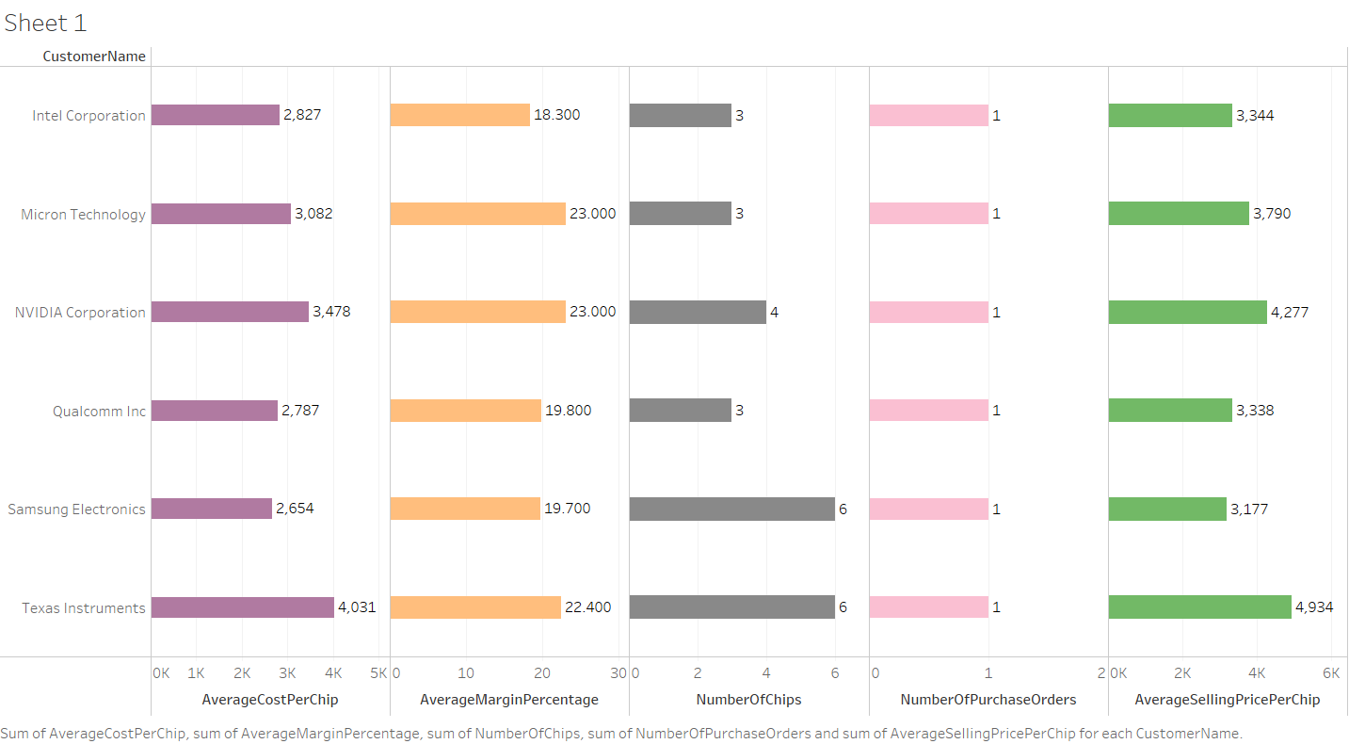
Visualizing Data – Financial Dashboard

Slide 17
Performance-to-Cost Ratio
The Performance-to-Cost Ratio is a metric used to evaluate the efficiency or value of a product, system, or service in terms of its performance relative to its cost. In the context of chip design or any technology product, this ratio can be particularly insightful for comparing different designs or models.
The Performance-to-Cost Ratio is calculated by dividing a measure of the product's performance by its cost. A higher ratio indicates that you're getting more performance per unit of cost, which is generally desirable. For instance, if you have two chip designs and one has twice the performance of the other but costs the same, it will have a higher Performance-to-Cost Ratio.
The ratio is then used to compare different chip designs, indicating which designs offer more processing power per unit of cost. This analysis is valuable in product development and strategic decision-making, particularly in industries where both performance and cost efficiency are crucial.

Slide 18
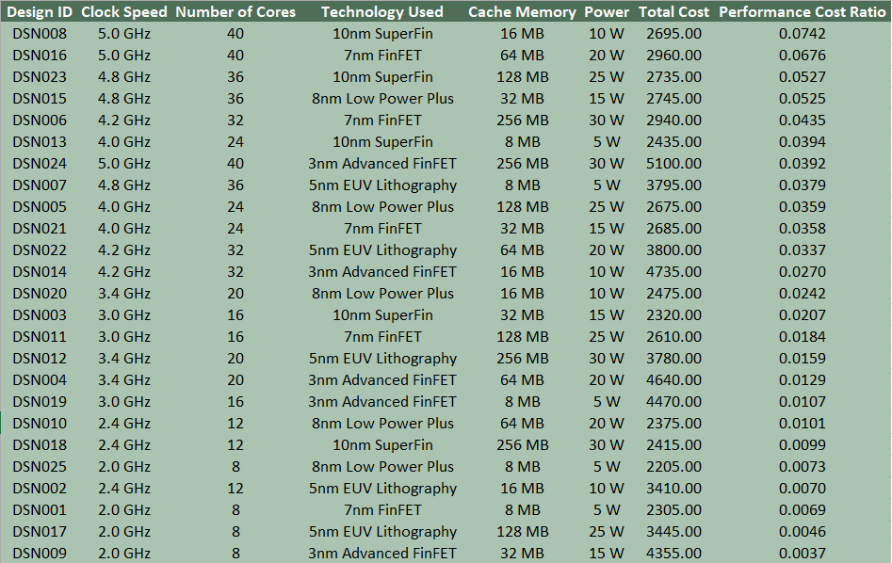
SQL Query – 3
Output
To achieve this output first I have calculated the total cost of each design by summing up individual component costs (clock speed, technology, core number, cache memory, power)
Then the performance-to-cost ratio is calculated by multiplying the clock speed with the number of cores, and then dividing this product by the total cost of the design.

Slide 19
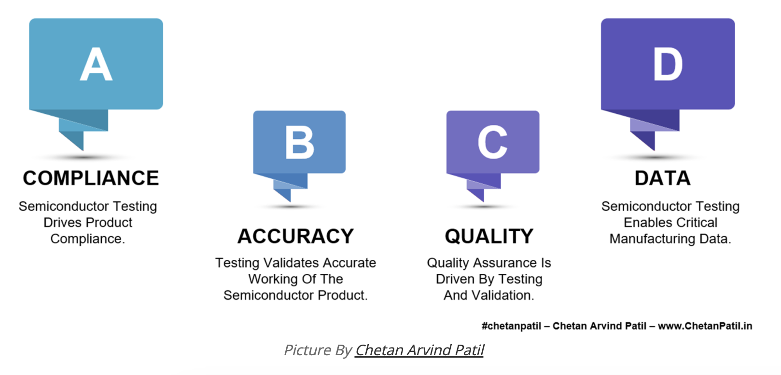
Testing In Semiconductor Manufacturing
Semiconductor testing assures functionality, conformance, sustainability of performance, and economic manufacturability essential for companies producing electronic components.
Catching defects and early life failures helps improve long-term reliability and lifespan for end users.

Slide 20
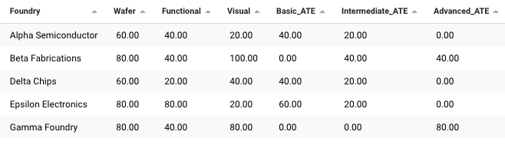
SQL Query – 4
The pass rates for semiconductor testing at each foundry, broken down by various testing methods such as wafer testing, functional testing, visual inspection, and automated test equipment usage.

Slide 21
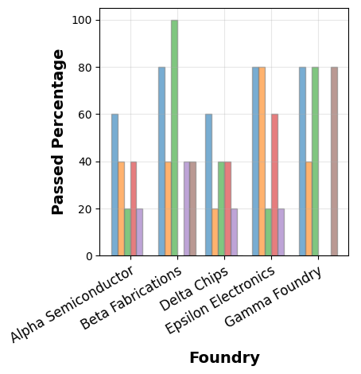
Visualizing Data

Slide 22
A review of lessons learned and Future directions
Refine the real-world applicability of the database by reviewing and adjusting initial assumptions, enhancing data models to reflect the complexities of the semiconductor supply chain, and ensuring scalability and compliance with industry standards. Implement advanced SQL features like stored procedures and triggers for automation and maintaining data integrity.
Develop a schema for real-time data capture to enable instantaneous supply chain adjustments.
Integrate SQL-based reporting tools to create dynamic dashboards for live operational insights.
Establish data warehouse solutions to support complex analytics, like forecasting and trend analysis.
Incorporate data security standards into the database design to protect sensitive supply chain information.

Slide 23
Conclusion
Successful creation of a detailed semiconductor supply chain database, enhancing data-driven decision-making.
Strengthened financial oversight with SQL queries that elucidate cost structures and customer transactions.
Demonstrated the database's capability in managing inventory, tracking orders, and predicting manufacturing needs.
Provided foundational support for strategic planning through comprehensive data on costs, sales, and margins.

Slide 24
THANK YOU

